Slide 1
Software Development Life Cycle (SDLC)

Slide 2
STUDENT LEARNING OUTCOMES
List the seven steps in the systems development life cycle (DSLC) and associated activities for each step.
Describe the four systems development methodologies.
Define the role of outsourcing.
List and describe the three different forms of outsourcing.
Describe business process outsourcing (BPO).
Describe prototyping and profile an example of a prototype.
Describe the advantages of prototyping.

Slide 3
Mercedes-Benz Online Built-to-Order Trucks
Mercedes-Benz allows customers to custom configure trucks online
Online program is called Truck Online Configurator
5 months to create application
Including development, testing and installation
Phases would overlap
This approach is called rapid application development (RAD)

Slide 4
Mercedes-Benz Online Built-to-Order Trucks
Class discussion…
Have you custom-ordered an auto? What was the process? Was it IT-enabled?
Why is custom ordering a competitive advantage?
What are some potential dangers of overlapping activities in any type of process?

Slide 5
INTRODUCTION
Information systems are the support structure for meeting the company’s strategies and goals
New systems are created because employees request it
New systems are created to obtain a competitive advantage

Slide 6
INTRODUCTION
Billions of dollars spent yearly on acquisition, design, development, implementation, and maintenance of IT systems
Companies depend on information more than ever

Slide 7
SYSTEMS DEVELOPMENT LIFE CYCLE (SDLC)
Systems development life cycle (SDLC) - a structured step-by-step approach for developing information systems
Typical activities include:
Determining budgets
Gathering business requirements
Designing models
Writing user documentation

Slide 8
SYSTEMS DEVELOPMENT LIFE CYCLE (SDLC)
SDLC PHASE | ACTIVITIES
Planning | Define the system to be developed Set the project scope Develop the project plan
Analysis | Gather business requirements
Design | Design the technical architecture Design system models
Development | Build technical architecture Build databases and programs
Testing | Write test conditions Perform testing
Implementation | Write user documentation Provide training
Maintenance | Build a help desk Support system changes

Slide 9
SYSTEMS DEVELOPMENT LIFE CYCLE (SDLC)
The SDLC has 7 phases:
Planning
Analysis
Design
Development
Testing
Implementation
Maintenance

Slide 10
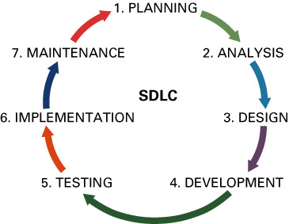
SYSTEMS DEVELOPMENT LIFE CYCLE (SDLC)

Slide 11
Phase 1: Planning
Planning phase - involves determining a solid plan for developing your information system
Three primary planning activities:
Define the system to be developed
Critical success factor (CSF) - a factor simply critical to your organization’s success

Slide 12
Phase 1: Planning
Set the project scope
Project scope - clearly defines the high-level system requirements
Scope creep - occurs when the scope of the project increases
Feature creep - occurs when developers add extra features that were not part of the initial requirements
Project scope document - a written definition of the project scope and is usually no longer than a paragraph

Slide 13
Phase 1: Planning
Develop the project plan including tasks, resources, and timeframes
Project plan - defines the what, when, and who questions of system development
Project manager - an individual who is an expert in project planning and management, defines and develops the project plan and tracks the plan to ensure all key project milestones are completed on time
Project milestones - represent key dates for which you need a certain group of activities performed

Slide 14
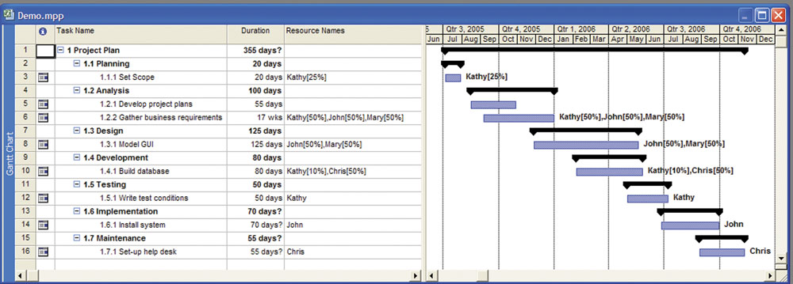
Phase 1: Planning

Slide 15
Phase 2: Analysis
Analysis phase - involves end users and IT specialists working together to gather, understand, and document the business requirements for the proposed system

Slide 16
Phase 2: Analysis
Two primary analysis activities:
Gather the business requirements
Business requirements - the detailed set of knowledge worker requests that the system must meet in order to be successful
Joint application development (JAD) - knowledge workers and IT specialists meet, sometimes for several days, to define or review the business requirements for the system

Slide 17
Phase 2: Analysis
Prioritize the requirements
Requirements definition document – prioritizes the business requirements and places them in a formal comprehensive document

Slide 18
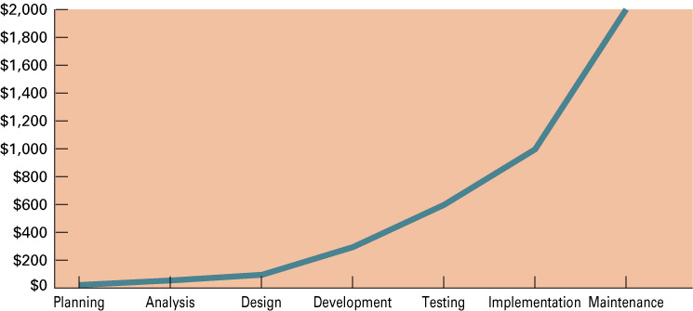
Phase 2: Analysis

Slide 19
Phase 3: Design
Design phase - build a technical blueprint of how the proposed system will work
Two primary design activities:
Design the technical architecture
Technical architecture - defines the hardware, software, and telecommunications equipment required to run the system

Slide 20
Phase 3: Design
Design system models
Modeling - the activity of drawing a graphical representation of a design
Graphical user interface (GUI) - the interface to an information system
GUI screen design - the ability to model the information system screens for an entire system

Slide 21
Phase 4: Development
Development phase - take all of your detailed design documents from the design phase and transform them into an actual system
Two primary development activities:
Build the technical architecture
Build the database and programs
Both of these activities are mostly performed by IT specialists

Slide 22
Phase 5: Testing
Testing phase - verifies that the system works and meets all of the business requirements defined in the analysis phase
Two primary testing activities:
Write the test conditions
Test conditions - the detailed steps the system must perform along with the expected results of each step

Slide 23
Phase 5: Testing
Perform the testing of the system
Unit testing – tests individual units of code
System testing – verifies that the units of code function correctly when integrated
Integration testing – verifies that separate systems work together
User acceptance testing (UAT) – determines if the system satisfies the business requirements

Slide 24
Phase 6: Implementation
Implementation phase - distribute the system to all of the knowledge workers and they begin using the system to perform their everyday jobs
Two primary implementation activities
Write detailed user documentation
User documentation - highlights how to use the system

Slide 25
Phase 6: Implementation
Provide training for the system users
Online training - runs over the Internet or off a CD-ROM
Workshop training - is held in a classroom environment and lead by an instructor

Slide 26
Phase 6: Implementation
Choose the right implementation method
Parallel implementation – use both the old and new system simultaneously
Plunge implementation – discard the old system completely and use the new
Pilot implementation – start with small groups of people on the new system and gradually add more users
Phased implementation – implement the new system in phases

Slide 27
Phase 7: Maintenance
Maintenance phase - monitor and support the new system to ensure it continues to meet the business goals
Two primary maintenance activities:
Build a help desk to support the system users
Help desk - a group of people who responds to knowledge workers’ questions
Provide an environment to support system changes

Slide 28
SYSTEMS DEVELOPMENT METHODOLOGIES
Developers have different development methodologies:
Waterfall methodology
Rapid application development (RAD)
Extreme programming (XP)
Agile methodology

Slide 29
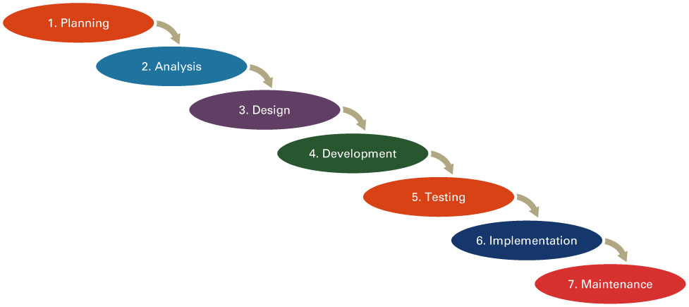
Waterfall Methodology
Waterfall methodology - a sequential, activity-based process in which each phase in the SDLC is performed sequentially from planning through implementation

Slide 30
Rapid Application Development (RAD)
Rapid application development (RAD) (also called rapid prototyping) - emphasizes extensive user involvement in the rapid and evolutionary construction of working prototypes of a system to accelerate the systems development process
Prototype - a smaller-scale, representation, or working model of the user’s requirements or a proposed design for an information system

Slide 31
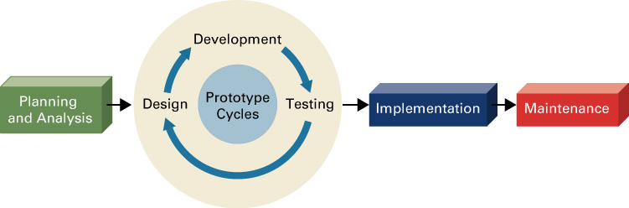
Rapid Application Development (RAD)

Slide 32
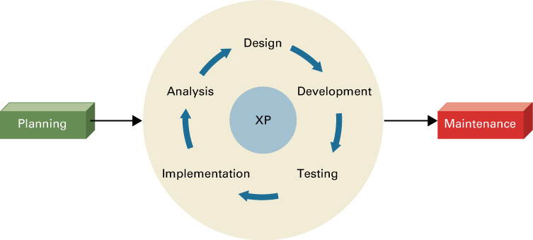
Extreme Programming (XP)
Extreme programming (XP) - breaks a project into tiny phases and developers cannot continue on to the next phase until the first phase is complete

Slide 33
Agile Methodology
Agile methodology - a form of XP, aims for customer satisfaction through early and continuous delivery of useful software components

Slide 34
OUTSOURCING
Two primary choices to build IT systems (of great size and complexity):
Insourcing - involves choosing IT specialists within your organization to develop the system
Outsourcing - the delegation of specific work to a third party for a specified length of time, at a specified cost, and at a specified level of service

Slide 35
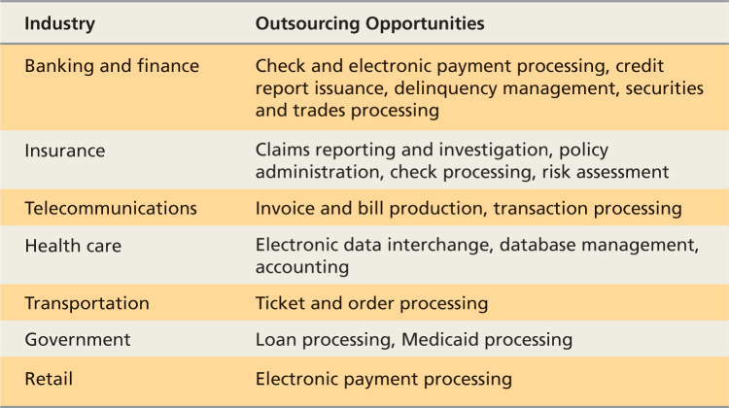
OUTSOURCING

Slide 36
OUTSOURCING
The main reasons behind the rapid growth of the outsourcing industry include the following:
Globalization and the Internet
Growing economy and low unemployment rate
Technology and deregulation
Request for proposal (RFP) – outsourcing document that informs vendors of your logical requirements

Slide 37
Outsourcing Options
IT outsourcing for software development can take one of four forms:
Purchase existing software
Purchase existing software and paying the publisher to make certain modifications
Purchase existing software and paying the publisher for the right to make modifications yourself
Outsource the development of an entirely new and unique system for which no software exists

Slide 38
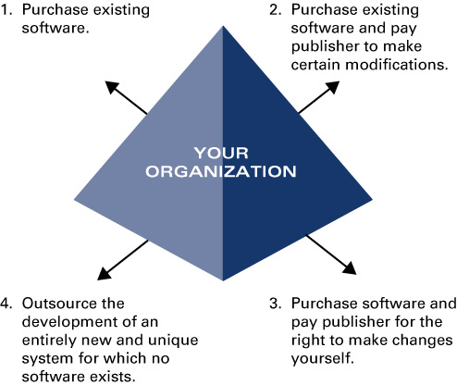
Outsourcing Options

Slide 39
Outsourcing Options
There are three different forms of outsourcing:
Onshore outsourcing - the process of engaging another company within the same country for services
Nearshore outsourcing - contracting an outsourcing arrangement with a company in a nearby country
Offshore outsourcing - contracting with a company that is geographically far away

Slide 40
Offshore Outsourcing
Primary outsourcing countries are:
India
China
Eastern Europe (including Russia)
Ireland
Israel
Philippines

Slide 41
The Advantages and Disadvantages of Outsourcing
Advantages:
Focus on unique core competencies
Exploit the intellect of another organization
Better predict future costs
Acquire leading-edge technology
Reduce costs
Improve performance accountability

Slide 42
The Advantages and Disadvantages of Outsourcing
Disadvantages:
Reduces technical know-how for future innovation
Reduces degree of control
Increases vulnerability of your strategic information
Increases dependency on other organizations

Slide 43
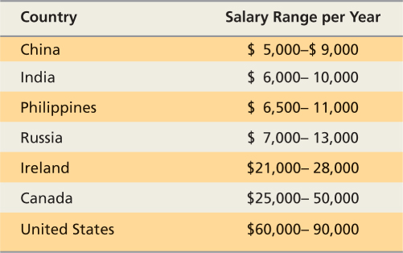
The Advantages and Disadvantages of Outsourcing

Slide 44
Business Process Outsourcing (BPO)
Business process outsourcing (BPO) is using a contractual service to completely manage, deliver and operate one or more (typically IT or call center-intensive) business processes or functions

Slide 45
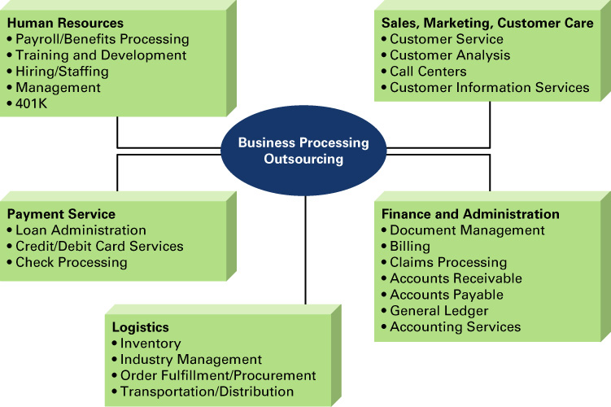
Business Process Outsourcing (BPO)

Slide 46
PROTOTYPING
Prototyping - the process of building a model that demonstrates the features of a proposed product, service, or system
Proof-of-concept prototype - used to prove the technical feasibility of a proposed system
Selling prototype - used to convince people of the worth of a proposed system

Slide 47
The Prototyping Process
The prototyping process involves four steps:
Identify basic requirements
Develop initial prototype
User review
Revise and enhance the prototype

Slide 48
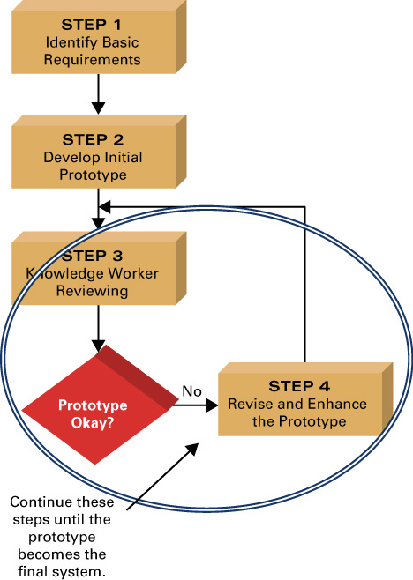
The Prototyping Process

Slide 49
Advantages of Prototyping
Encourages Active User Participation
Helps Resolve Discrepancies Among Users
Gives Users a Feel for the Final System
Helps Determine Technical Feasibility
Helps Sell the Idea of a Proposed System

Slide 50
Disadvantages of Prototyping
Leads People to Believe the Final System Will Follow
Gives No Indication of Performance under Operational Conditions
Leads the Project Team to Forgo Proper Testing and Documentation

Slide 51
END-USER DEVELOPMENT
End-user development (EUD) is the collection of techniques and methodologies for the creation of non-trivial software applications by end users
A successful strategy relies on two keys:
Knowing which applications are good candidates
Providing end users with the right tools

Slide 52
Which Applications to Offload
Infrastructure-related
Mission-critical including ERP, CRM, Business Intelligence and e-business
High value to the enterprise not just a single line of business
Support large numbers of concurrent users’ for example, call center applications

Slide 53
The Right Tool for the Job
End users must have development tools that:
Are easy to use
Support multiple platforms
Offer low cost of ownership
Support a wide range of data types

Slide 54
The Right Tool for the Job
Not all end-user development is greatly accepted because of:
Version control
Low quality
Loss of control

Slide 55
CAN YOU…
List the seven steps in the systems development life cycle (DSLC) and associated activities for each step.
Describe the four systems development methodologies.
Define the role of outsourcing.

Slide 56
CAN YOU…
List and describe the three different forms of outsourcing.
Describe business process outsourcing (BPO).
Describe prototyping and profile an example of a prototype.
Describe the advantages of prototyping.

